Slide 1
Computer Graphics and Multimedia Systems SCS1302
Unit 2

Slide 2
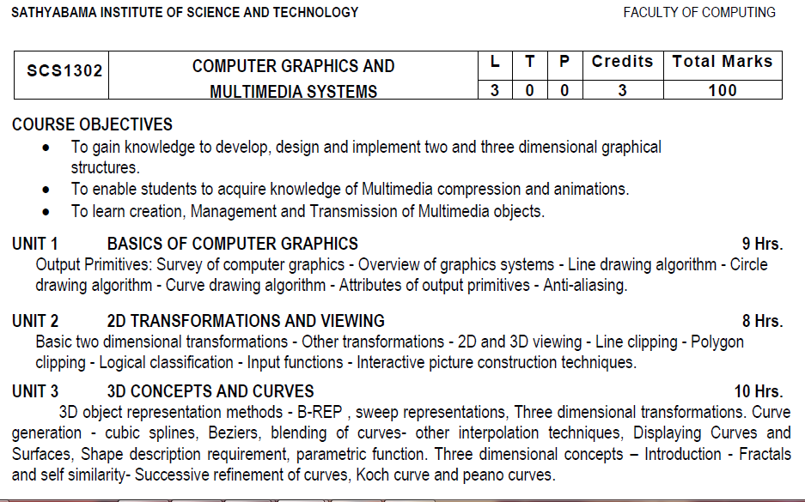
Syllabus

Slide 3
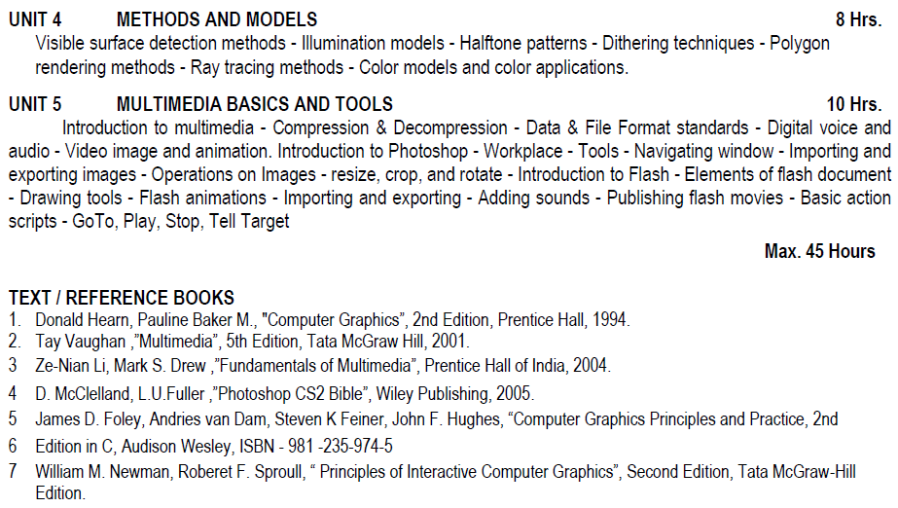
Syllabus

Slide 4
Course Objective(CO)
CO1: Construct lines and circles for the given input.
CO2: Apply 2D transformation techniques to transform the shapes to fit them as per the picture definition.
CO3: Construct splines, curves and perform 3D transformations
CO4: Apply colour and transformation techniques for various applications.
CO5: Analyse the fundamentals of animation, virtual reality, and underlying technologies.
CO6: Develop photo shop applications

Slide 5
2D VIEWING
The mapping of a 2D world coordinate system to device coordinates is called a two-dimensional viewing transformation.
The clipping window is the section of the 2D scene that is selected for viewing.
The display window is where the scene will be viewed.
The viewport controls the placement of the scene within the display window

Slide 6
2D VIEWING
The process of mapping a part of the world co-ordinate scene to device co-ordinate system is known as viewing transformation.
A world co-ordinate area selected for display is called as a window and an area on display device to which a window is mapped is called as a view point.
Window defines ‘What’ to be viewed and the viewport defines ‘Where’ it is to be displayed

Slide 7
2D VIEWING
A window-viewport transformation describes the mapping of a (rectangular) window in one coordinate system into another (rectangular) window in another coordinate system.
This transformation is defined by the section of the original image that is transformed (clipping window), the location of the resulting window (viewport), and how the window is translated, scaled or rotated

Slide 8
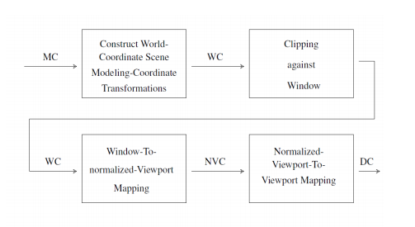
2D VIEWING

Slide 9
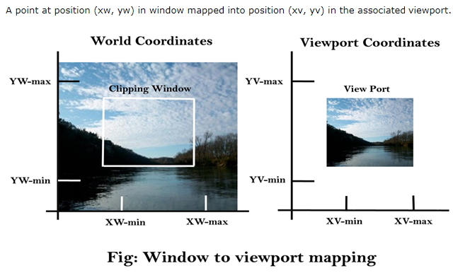

Slide 10
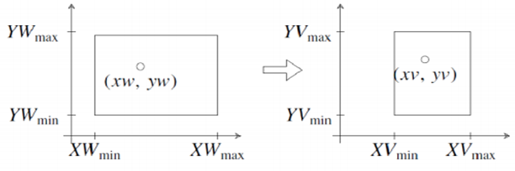

Slide 11
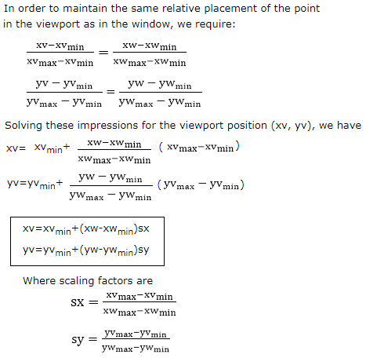

Slide 12
Clipping
When we have to display a large portion of the picture, then not only scaling & translation is necessary, the visible part of picture is also identified. This process is not easy. Certain parts of the image are inside, while others are partially inside. The lines or elements which are partially visible will be omitted.
For deciding the visible and invisible portion, a particular process called clipping is used. Clipping determines each element into the visible and invisible portion. Visible portion is selected. An invisible portion is discarded.

Slide 13
Types of Lines
Lines are of three types:
Visible: A line or lines entirely inside the window is considered visible
Invisible: A line entirely outside the window is considered invisible
Clipped: A line partially inside the window and partially outside is clipped. For clipping point of intersection of a line with the window is determined.

Slide 14
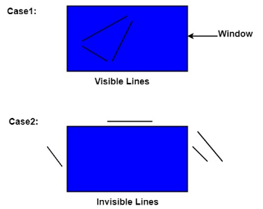
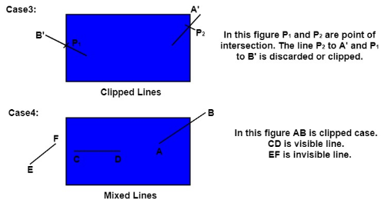
Example: Types of Lines

Slide 15
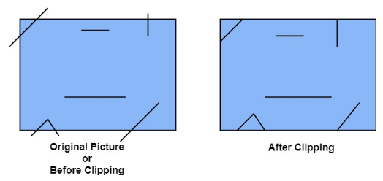
Before and after clipping
The window against which object is clipped called a clip window. It can be curved or rectangle in shape.

Slide 16
Applications of clipping
Clipping can be applied to world co-ordinates. The contents inside the window will be mapped to device co-ordinates. Another alternative is a complete world co-ordinates picture is assigned to device co-ordinates, and then clipping of viewport boundaries is done.
It will extract part we desire.
For identifying the visible and invisible area in the 3D object.
For creating objects using solid modeling.
For drawing operations.
Operations related to the pointing of an object.
For deleting, copying, moving part of an object.

Slide 17
Types of Clipping
Point Clipping
Line Clipping
Area Clipping (Polygon)
Curve Clipping
Text Clipping
Exterior Clipping

Slide 18
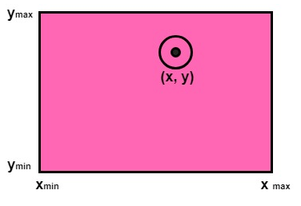
Point Clipping
Point Clipping is used to determining, whether the point is inside the window or not. For this following conditions are checked.
x_{wmin} ≤ x ≤ x_{wmax}
Y_{wmin} ≤ Y ≤ Y_{wmax}
The (x, y) is coordinate of the point. If anyone from the above inequalities is false, then the point will fall outside the window and will not be considered to be visible.

Slide 19
Text Clipping
Various techniques are used to provide text clipping in a computer graphics. It depends on the methods used to generate characters and the requirements of a particular application. There are three methods for text clipping which are listed below −
All or none string clipping
All or none character clipping
Text clipping

Slide 20
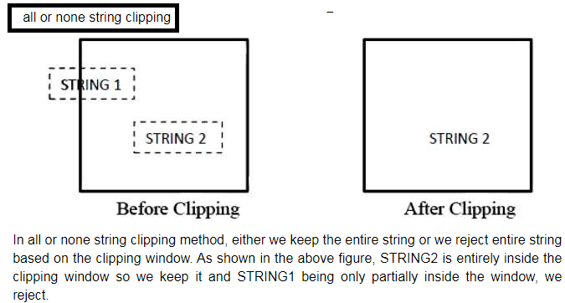
All or None String Clipping

Slide 21
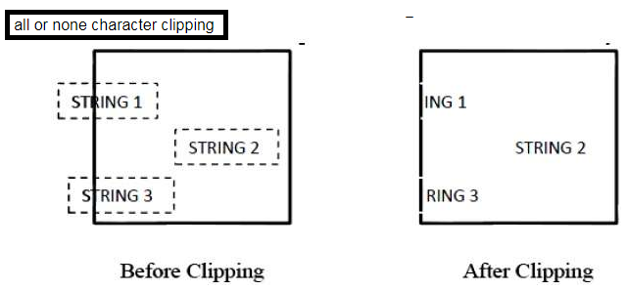
All or None Character Clipping

Slide 22
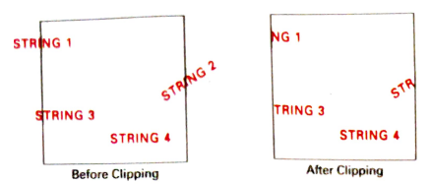
Text clipping (using a bounding rectangle about individual characters)

Slide 23
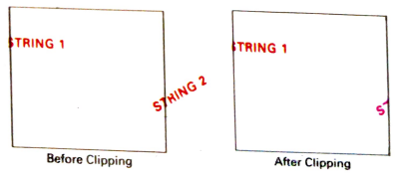
Text clipping (performed on the components of individual characters)

Slide 24
Curve Clipping, Polygon and Exterior Clipping
Curve Clipping:
Curve Clipping involves complex procedures as compared to line clipping. Curve clipping requires more processing than for object with linear boundaries. Consider window which is rectangular in shape. The circle is to consider against rectangle window. If circle is completely inside boundary of the window, it is considered visible. So save the circle. If a circle is in outside window, discard it. If circle cut the boundary then consider it to be clipping case
Polygon Clipping:
Polygon clipping is applied to the polygons. The term polygon is used to define objects having outline of solid. These objects should maintain property and shape of polygon after clipping..
Exterior Clipping:
It is opposite to previous clipping. Here picture which is outside the window is considered. The picture inside the rectangle window is discarded. So part of the picture outside the window is saved.
Uses of Exterior Clipping:
It is used for displaying properly the pictures which overlap each other.
It is used in the concept of overlapping windows.
It is used for designing various patterns of pictures.
It is used for advertising purposes.
It is suitable for publishing.
For designing and displaying of the number of maps and charts, it is also used.

Slide 25
LINE CLIPPING & POLYGON CLIPPING ALGORITHMS
Line clipping algorithms:
Cohen–Sutherland
Liang–Barsky
Nicholl–Lee–Nicholl
Polygon clipping algorithms:
Sutherland–Hodgman
Weiler–Atherton

Slide 26
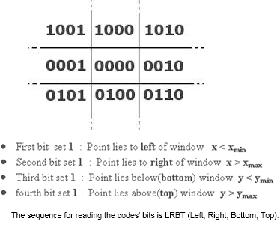
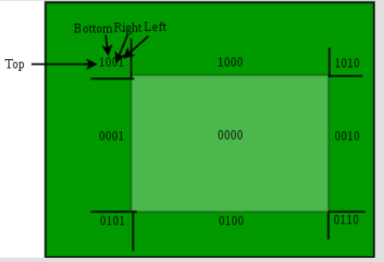
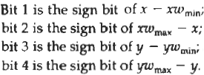
COHEN-SUTHERLAND LINE CLIPPING ALGORITHM

Slide 27
Bit 4, Bit 3, Bit 2, Bit 1 =
Top, Bottom, Right, Left.
1 0 0 1

Slide 28
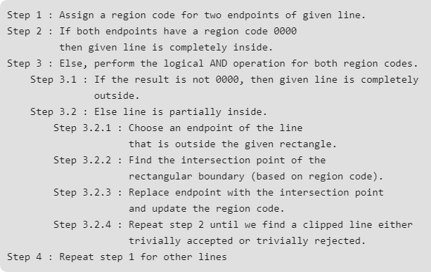
Pseudocode

Slide 29
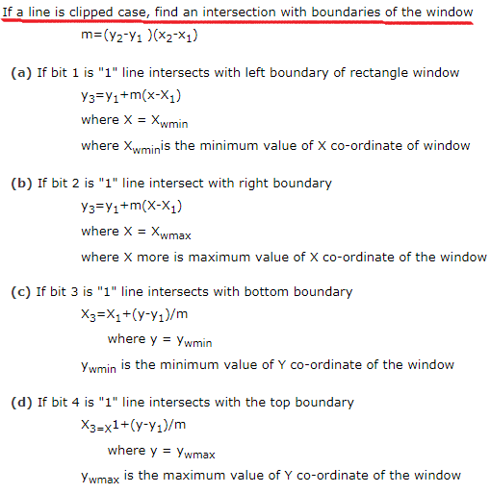
Pseudocode

Slide 30
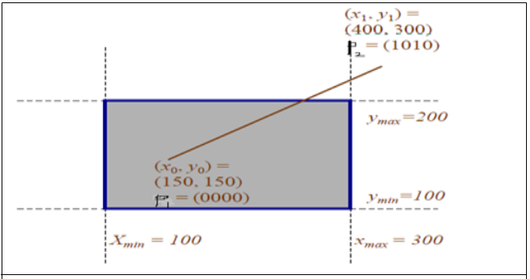
COHEN-SUTHERLAND LINE CLIPPING ALGORITHM
For P1(150,150):
(From Right to Left)
Bit 1 : x - xmin = 150 - 100 = 50 =>set the bit to 0 (zero - as sign of 50 is +)
Bit 2: xmax – x = 300 – 150 = 150 => set the bit to 0
Bit 3: y - ymin = 150 - 100 = 50 => set the bit to 0
Bit 4: ymax – y = 200 – 150 = 50 => set the bit to 0
So, the region code for P1 is 0000.
That implies P1 is inside the Clip Window.

Slide 31
COHEN-SUTHERLAND LINE CLIPPING ALGORITHM
For P2(400,300):
(From Right to Left)
Bit 1 : x - xmin = 400 - 100 = 300
=>set the bit to 0 (zero, as sign of 300 is +)
Bit 2: xmax – x = 300 – 400 = - 100
=> set the bit to 1 (one, as sign of 100 is -)
Bit 3: y - ymin = 300 - 100 = 0
=> set the bit to 0
Bit 4: ymax – y = 200 – 300 = - 100
=> set the bit to 1
So, the region code for P2 is 1010.
That implies P2 is in the top and above the Clip Window.

Slide 32
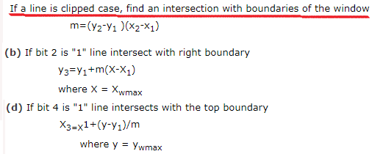
Intersection Point
Region code of P1 is 0000.
Region code of P2 is 1010.

Slide 33
COHEN-SUTHERLAND LINE CLIPPING ALGORITHM
To find the intersection point:
y = y1 + m ( x_{boundary} - x1)
where x_{boundary} is set either to xmin or xmax
x = x1 + ( y_{boundary} - y1) / m
Where y_{boundary} is set either to ymin or ymax
m= (y1-y0) / (x1-x0)
Therefore,
m = (300-150) / ( 400-150) = 0.6
x = x1 + ( y_{boundary} - y1) / m
Therefore,
x = 400 + (200 – 300) / 0.6 = 233
Here, y_{boundary} is the Ymax,
Therefore, the intersection point is,
(x, ymax) =(233, 200)

Slide 34
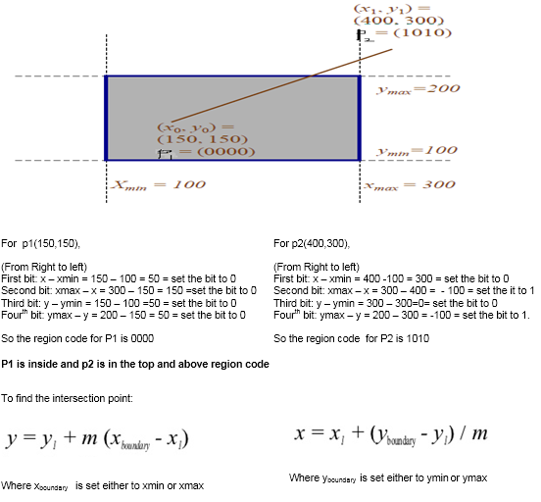
COHEN-SUTHERLAND LINE CLIPPING ALGORITHM

Slide 35
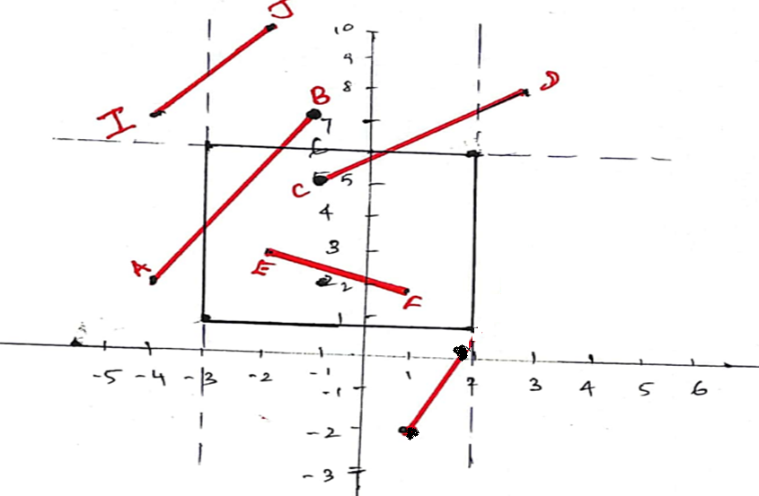
Example 2

Slide 36
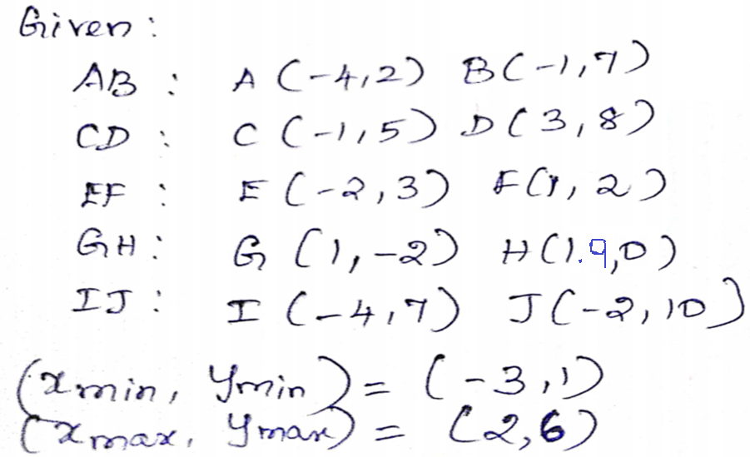
Example 2

Slide 37
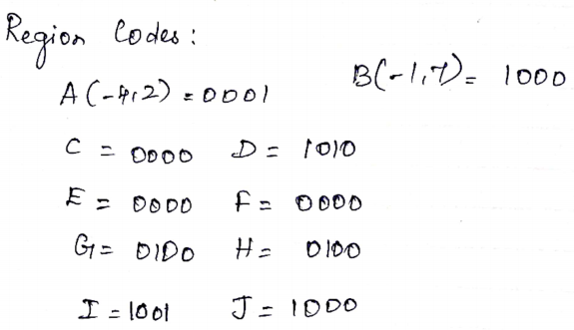
Example 2

Slide 38
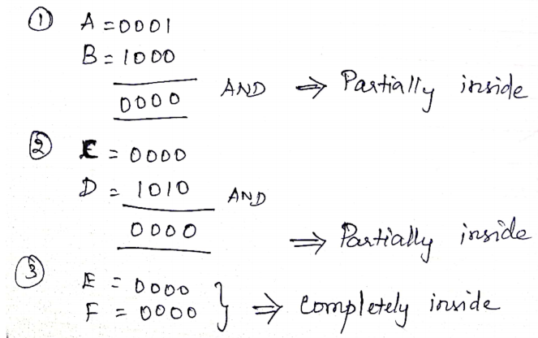
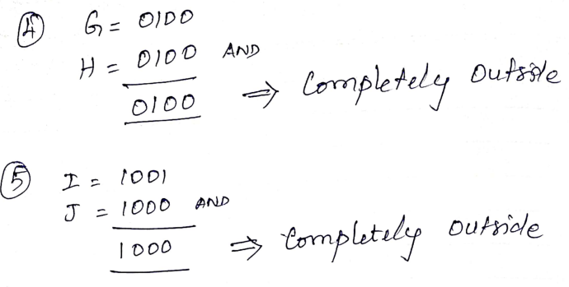
Example 2

Slide 39
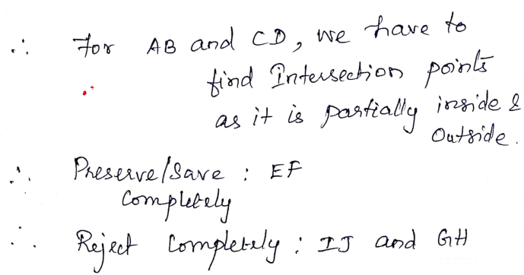
Example 2

Slide 40
Pseudocode

Slide 41
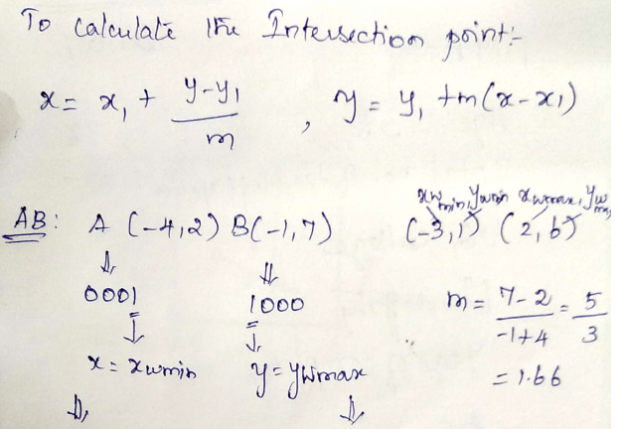
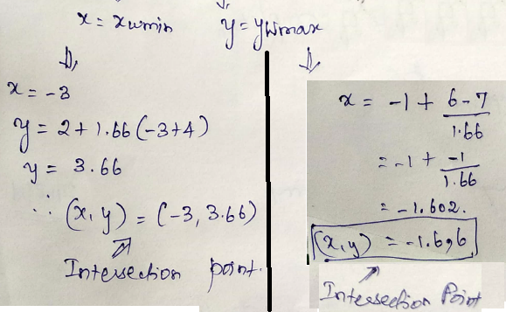
Example 2

Slide 42
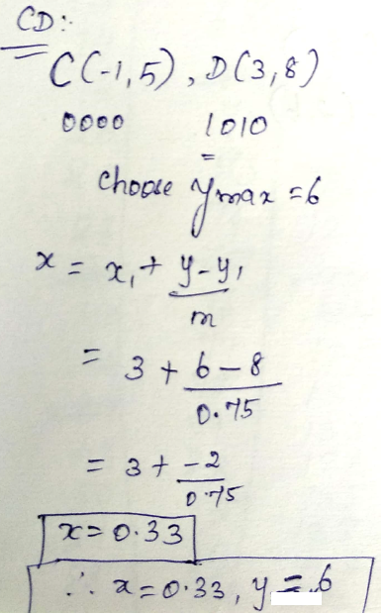
Example 2

Slide 43
Thank You

